Slide 1
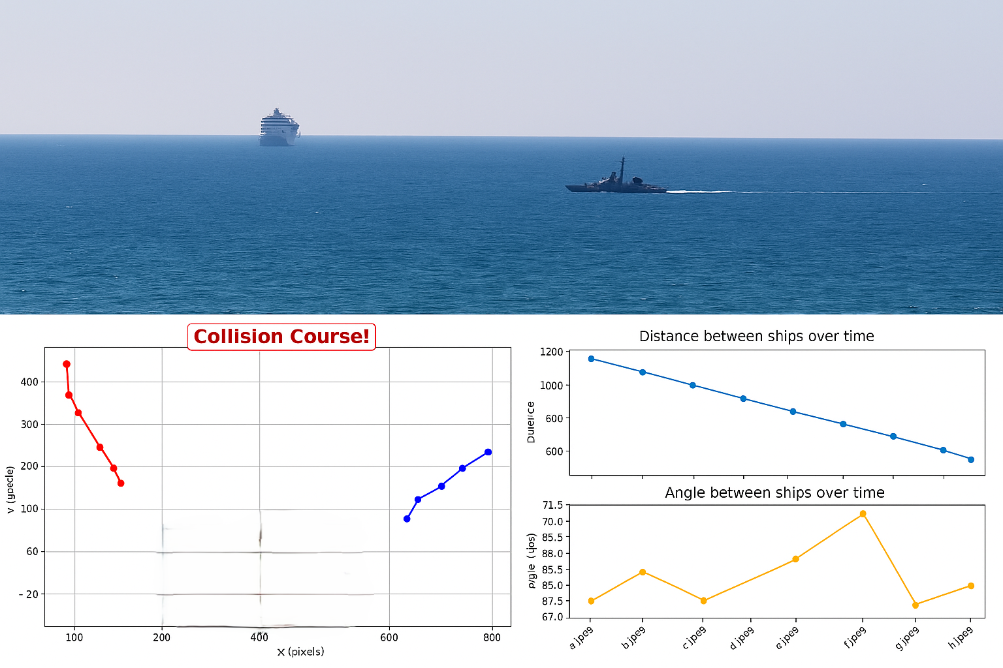

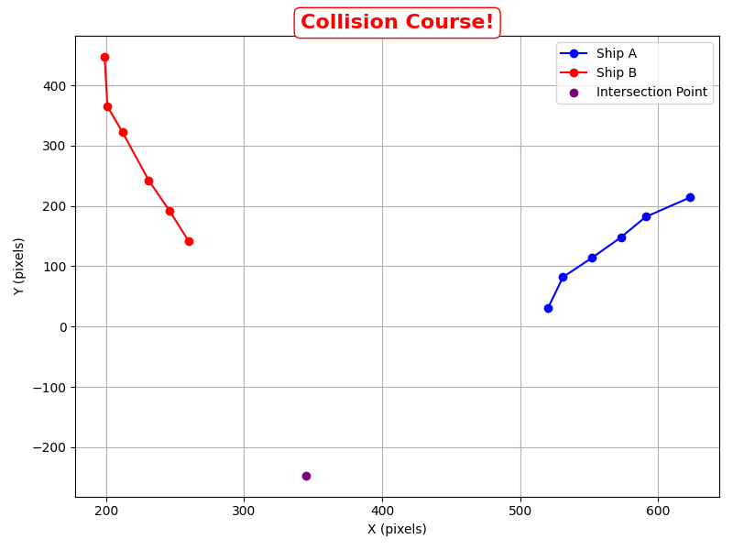
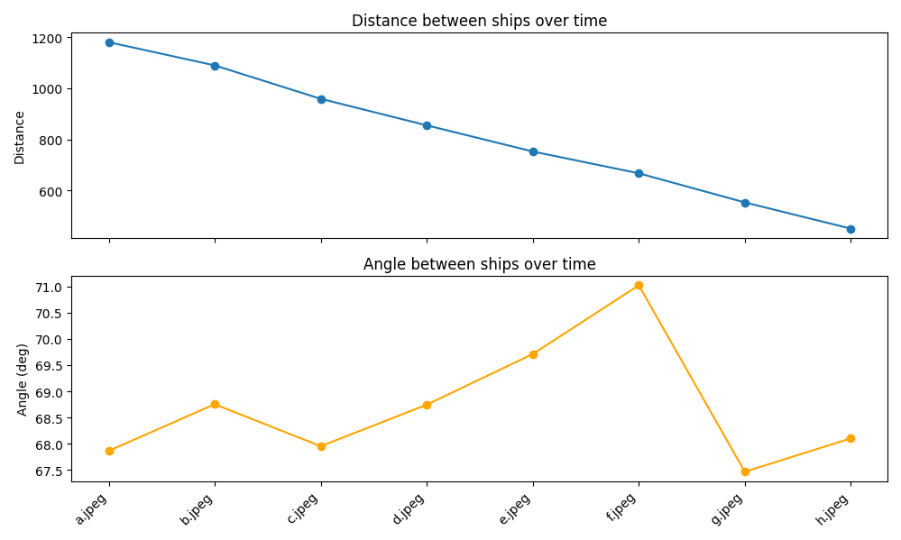
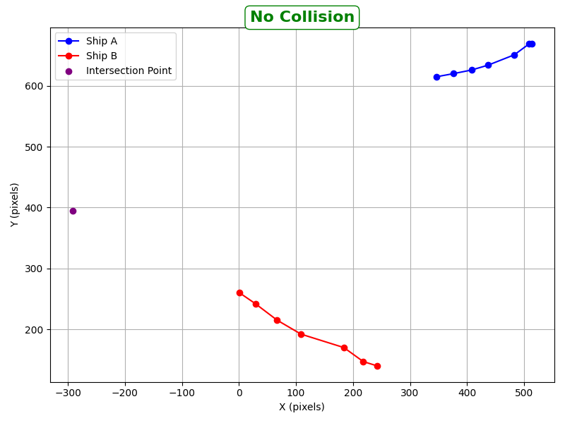

Collision Course Detection
Represented by Yehonatan Ezra & Denna Mhameed

Slide 2
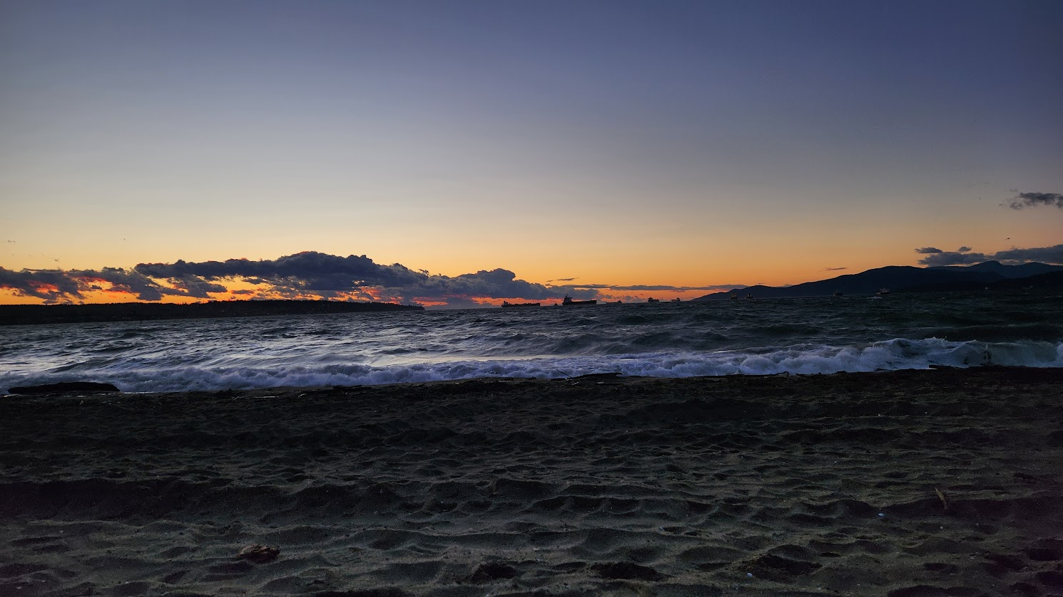
Overview
In this project we tried to solve this problem in several ways:
1) Overhead camera - a fixed camera that captures both ships in the scene.
- Homography Rectification + CBDR - Cross-Ratio + TTC
- Two Cameras
2) On-board camera - mounted on one ship, analyzing the relative motion.
- CBDR.

Slide 3
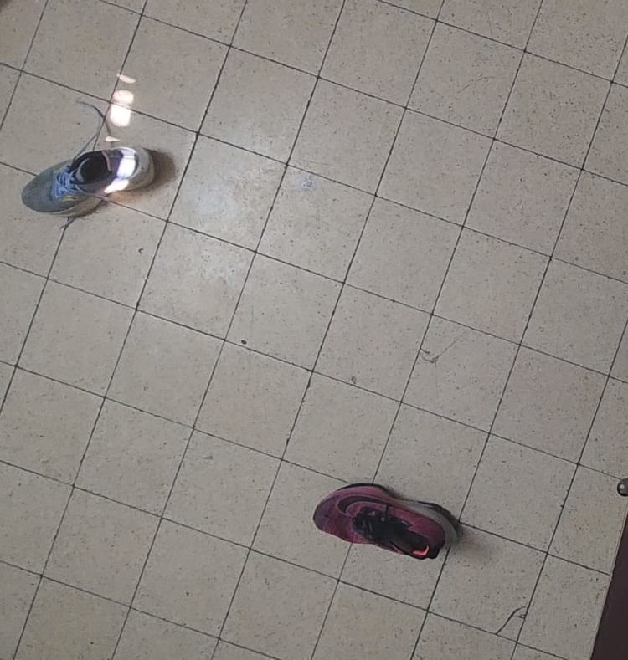

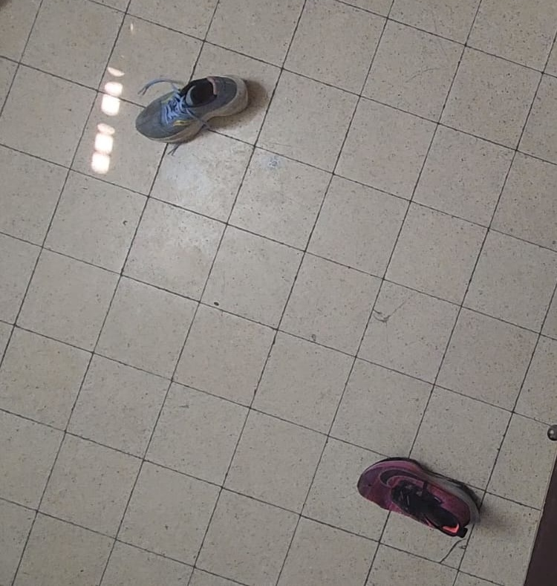
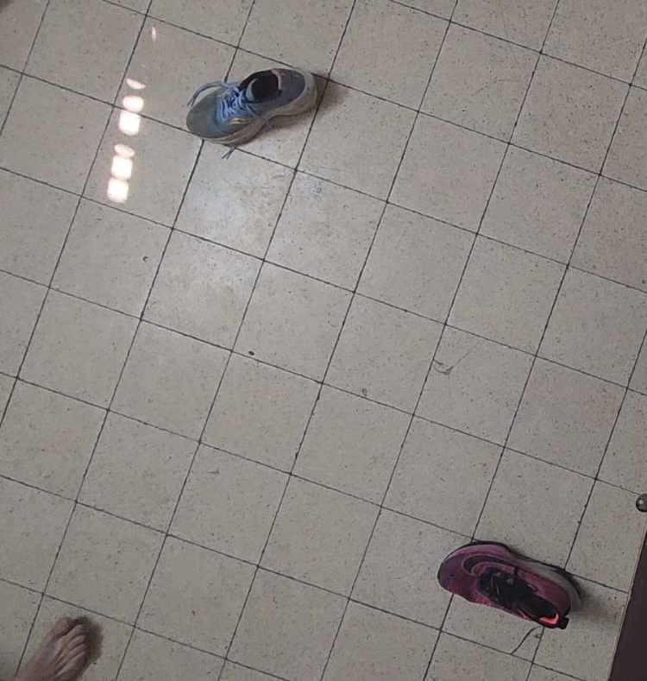
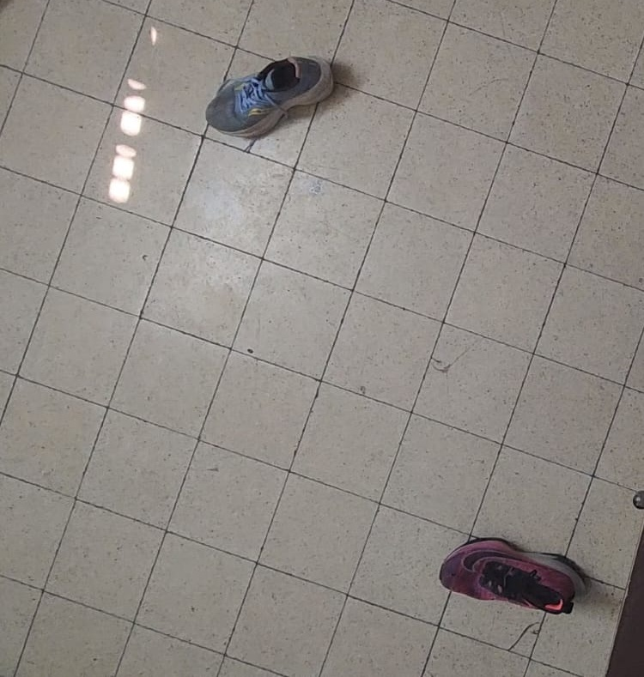
Overhead Camera
To simulate our code, we created scenes where ships are represented by shoes. Each frame shows two shoes moving relative to each other if they were ships.
...
Click to watch all our scenes - Scenes
Then we split the problem into two sub-approaches
1) Homography Rectification
2) Cross-Ratio + TTC
3) Two cameras

Slide 4
Homography Rectification
Ideally. We would like to estimate the heading direction and velocity to each ship and with this information, we can predict their future trajectories and check whether they will intersect. How ever, in raw images, perspective distortion makes distances and angles inconsistent:
Object further away appear smaller
Straight, parallel trajectories may appear curved or converging.
Distances and angles measured directly on the image are not reliable.
Solution:
Apply a homograph transformation to rectify the perspective and map the image to a consistent top-down plane.
-

Slide 5
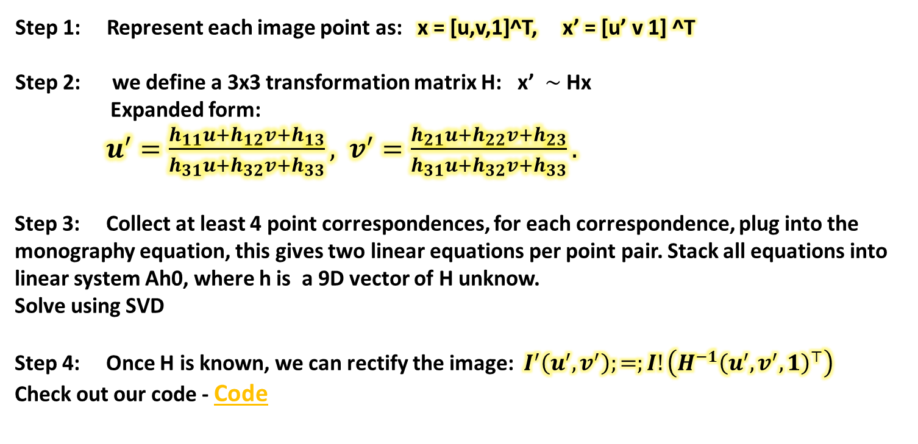
Homography Rectification - Mathematics
So how to rectify?
Step 1: Represent each image point as: x = [u,v,1]^T, x’ = [u’ v 1] ^T
Step 2: we define a 3x3 transformation matrix H: x’ $\sim$ Hx
Expanded form:
$u^{′}=\frac{h_{11}u+h_{12}v+h_{13}}{h_{31}u+h_{32}v+h_{33}}, v^{′}=\frac{h_{21}u+h_{22}v+h_{23}}{h_{31}u+h_{32}v+h_{33}}.$
Step 3: Collect at least 4 point correspondences, for each correspondence, plug into the monography equation, this gives two linear equations per point pair. Stack all equations into linear system Ah0, where h is a 9D vector of H unknow.
Solve using SVD
Step 4: Once H is known, we can rectify the image: $I^{′}\left(u^{′},v^{′}\right);=;I!\left(H^{−1}{\left(u^{′},v^{′},1\right)}^{⊤}\right)$
Check out our code - Code
~

Slide 6
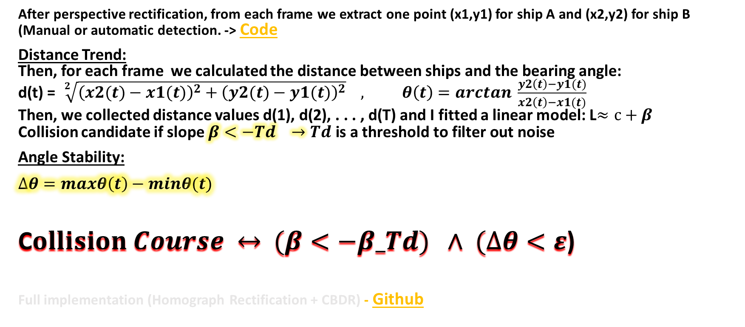
Collision Analysis after Rectification
After perspective rectification, from each frame we extract one point (x1,y1) for ship A and (x2,y2) for ship B (Manual or automatic detection. -> Code
Distance Trend:
Then, for each frame we calculated the distance between ships and the bearing angle:
d(t) = $\sqrt[2]{{\left(x2(t)−x1(t)\right)}^{2}+{\left(y2(t)−y1(t)\right)}^{2}} , θ\left(t\right)=arctan \frac{y2\left(t\right)−y1(t)}{x2\left(t\right)−x1(t)}$
Then, we collected distance values d(1), d(2), . . . , d(T) and I fitted a linear model: L$≈c+β$
Collision candidate if slope $β<−Td →Td \text{is} \text{a} \text{threshold} \text{to} \text{filter} \text{out} \text{noise}$
Angle Stability:
$$∆θ=maxθ\left(t\right)−minθ(t)$$
C$ollision Course ↔$ $(β<−β_Td) ∧$ $(∆θ<ε$)
Full implementation (Homograph Rectification + CBDR) - Github

Slide 7
Rectification is unreliable at sea
Up to now we relied on Homography rectification to solve our problem, but actually at sea, this is impractical:
No stable planar reference: no reliable 4 corners, water surface is dynamic.
Camera motion: shup roll/pitch yaw and vibration → time-varying geometry, a single H per sequence is invalid.
3D effects: Ships have height, not a single plane → planar rectification assumption break.
Changin pose: zoom or slight FOV changes, unknow height/tilt above water.
Solution - Cross Ratio!
Therefore, we use a projective invariant, Cross-Ratio , which does not change under hymnographies, requires only tracking points along each ship's path, and avoids explicit calibration.

Slide 8
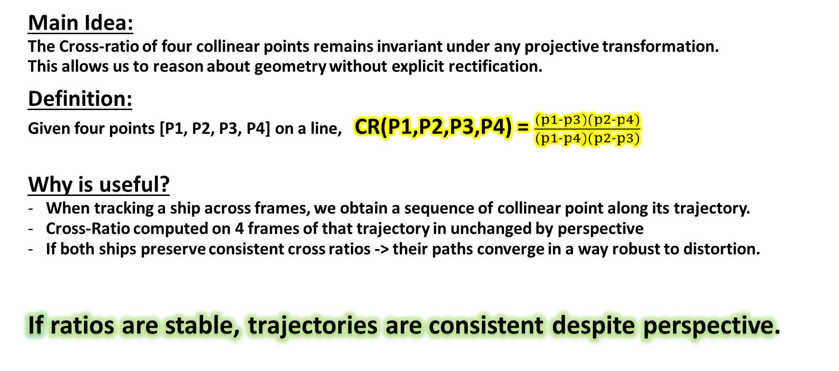
Cross Ratio + TTC
Main Idea:
The Cross-ratio of four collinear points remains invariant under any projective transformation.
This allows us to reason about geometry without explicit rectification.
Definition:
Given four points [P1, P2, P3, P4] on a line, CR(P1,P2,P3,P4) = $\frac{(p1−p3)(p2−p4)}{(p1−p4)(p2−p3)}$
Why is useful?
When tracking a ship across frames, we obtain a sequence of collinear point along its trajectory.
Cross-Ratio computed on 4 frames of that trajectory in unchanged by perspective
If both ships preserve consistent cross ratios -> their paths converge in a way robust to distortion.
If ratios are stable, trajectories are consistent despite perspective.

Slide 9
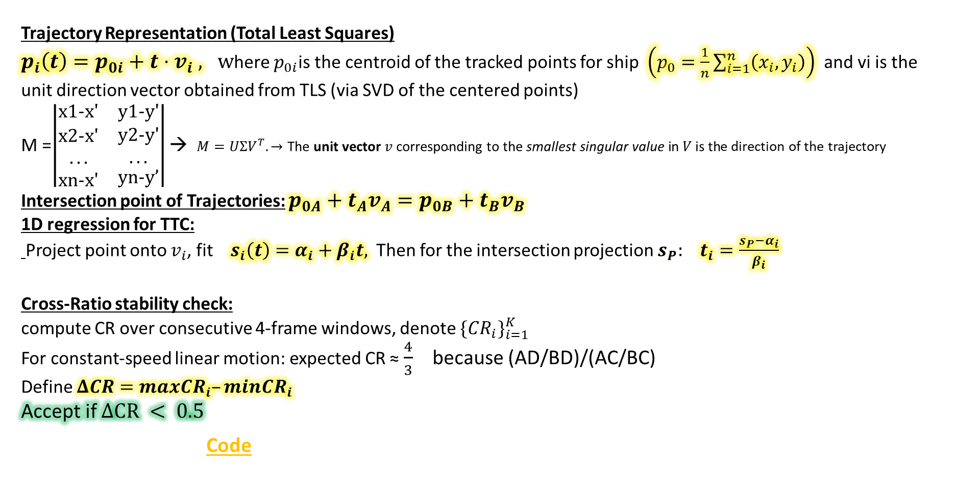
Trajectory Intersection and Time - to - Collision
Trajectory Representation (Total Least Squares) $p_{i}\left(t\right)=p_{0i}+t⋅v_{i} , w$here $p_{0i}$is the centroid of the tracked points for ship $\left(p_{0}=\frac{1}{n}\sum_{i=1}^{n}{\left(x_{i},y_{i}\right)}\right)$ and vi is the unit direction vector obtained from TLS (via SVD of the centered points)
M =$\left|\begin{matrix}x1-x' & y1-y' \\ \begin{aligned}x2-x' \\ ... \\ xn-x'\end{aligned} & \begin{aligned}\begin{aligned}y2-y' \\ ...\end{aligned} \\ yn-y’\end{aligned}\end{matrix}\right|$ → $M=UΣV^{T}. →\text{The} \text{unit} \text{vector} v \text{corresponding} \text{to} \text{the} \text{smallest} \text{singular} \text{value} \text{in} V \text{is} \text{th}$e direction of the trajectory
Intersection point of Trajectories: $p_{0A}+t_{A}v_{A}=p_{0B}+t_{B}v_{B}$
1D regression for TTC:
Project point onto $v_{i}$, fit $s_{i}\left(t\right)=α_{i}+β_{i}t,$ Then for the intersection projection $s_{P}:$ $t_{i}=\frac{s_{P}−α_{i}}{β_{i}}$
Cross-Ratio stability check:
compute CR over consecutive 4-frame windows, denote $\{CR_{i}\}_{i=1}^{K}$
For constant-speed linear motion: expected CR ≈ $\frac{4}{3}$ because (AD/BD)/(AC/BC)
Define $ΔCR=maxCR_{i}–minCR_{i}$
Accept if $∆CR < 0.5$
Our implementation - Code

Slide 10
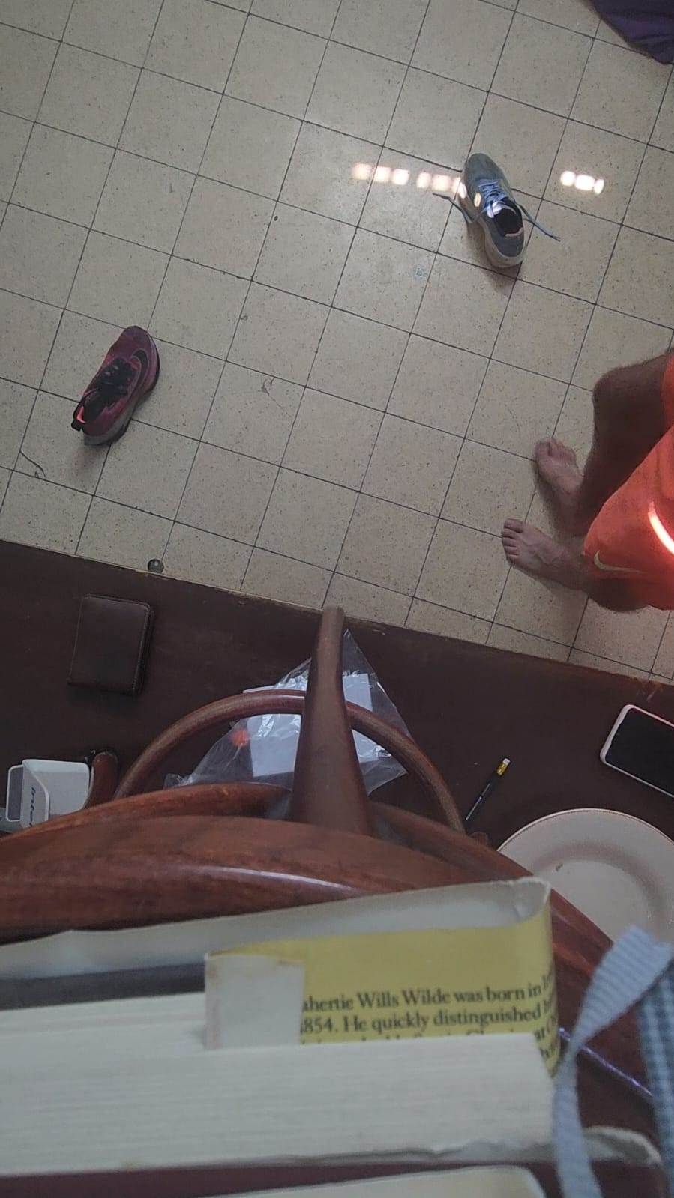
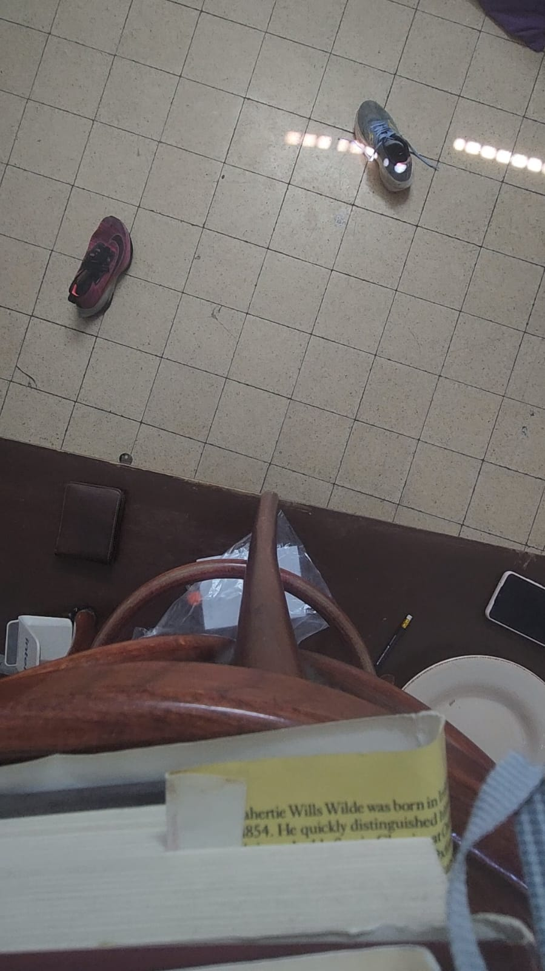
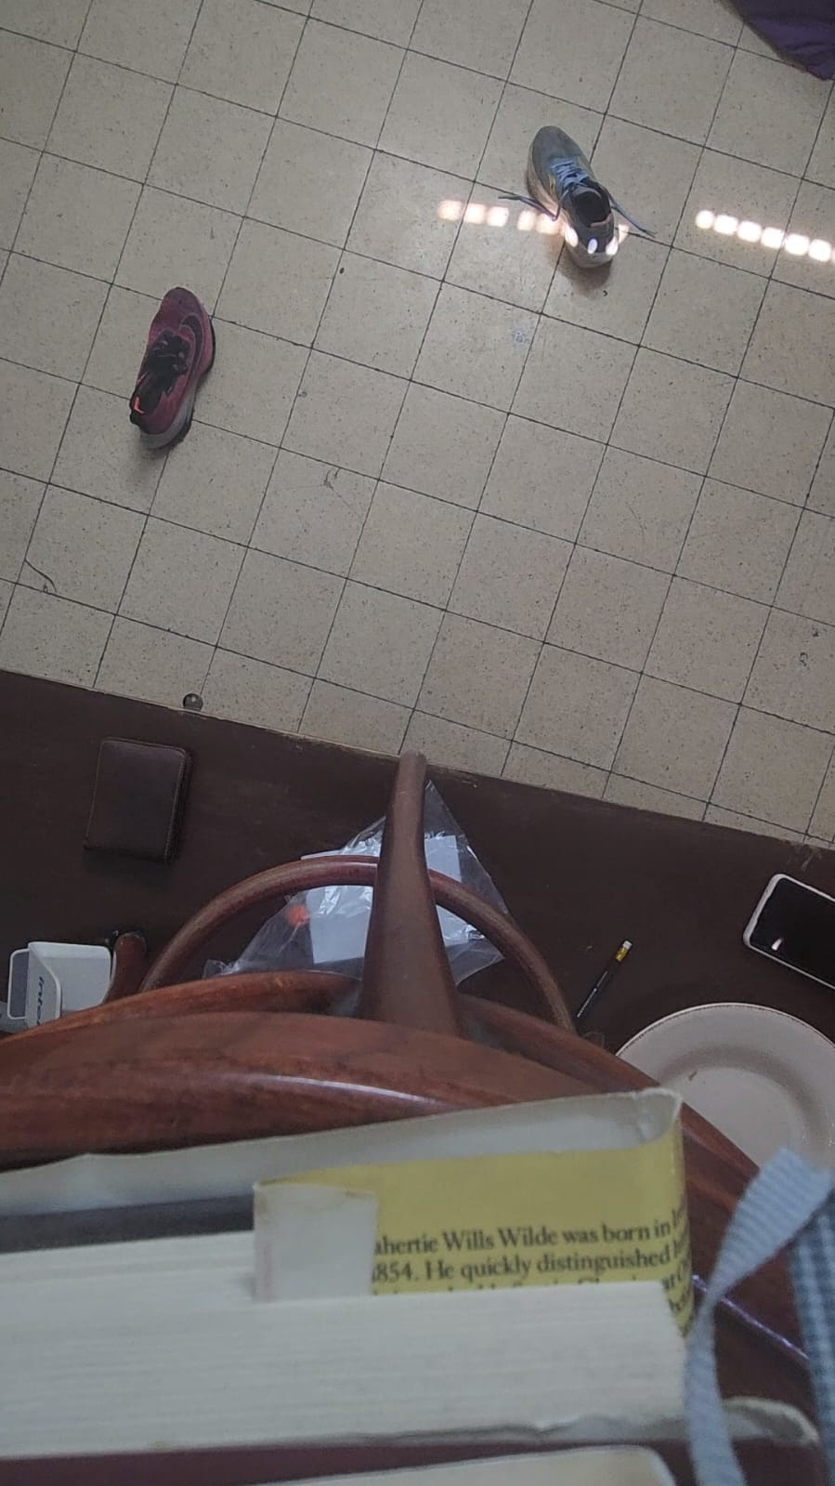
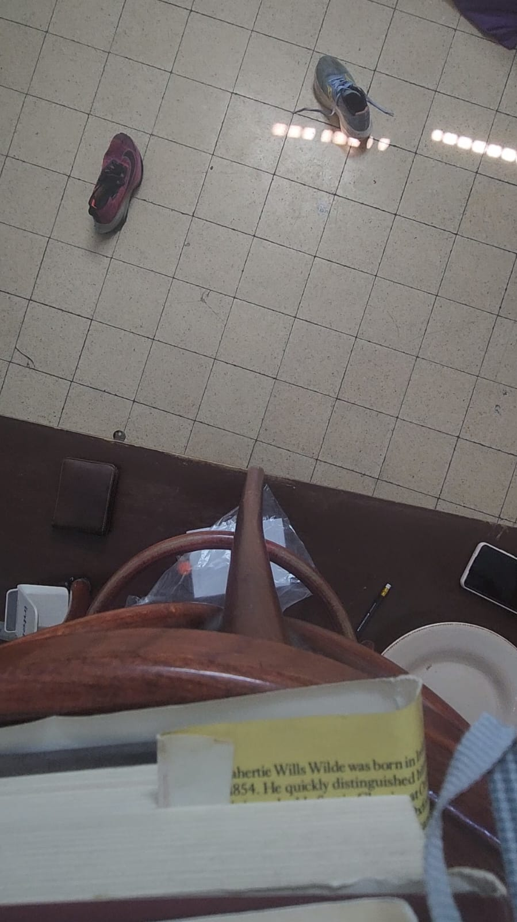
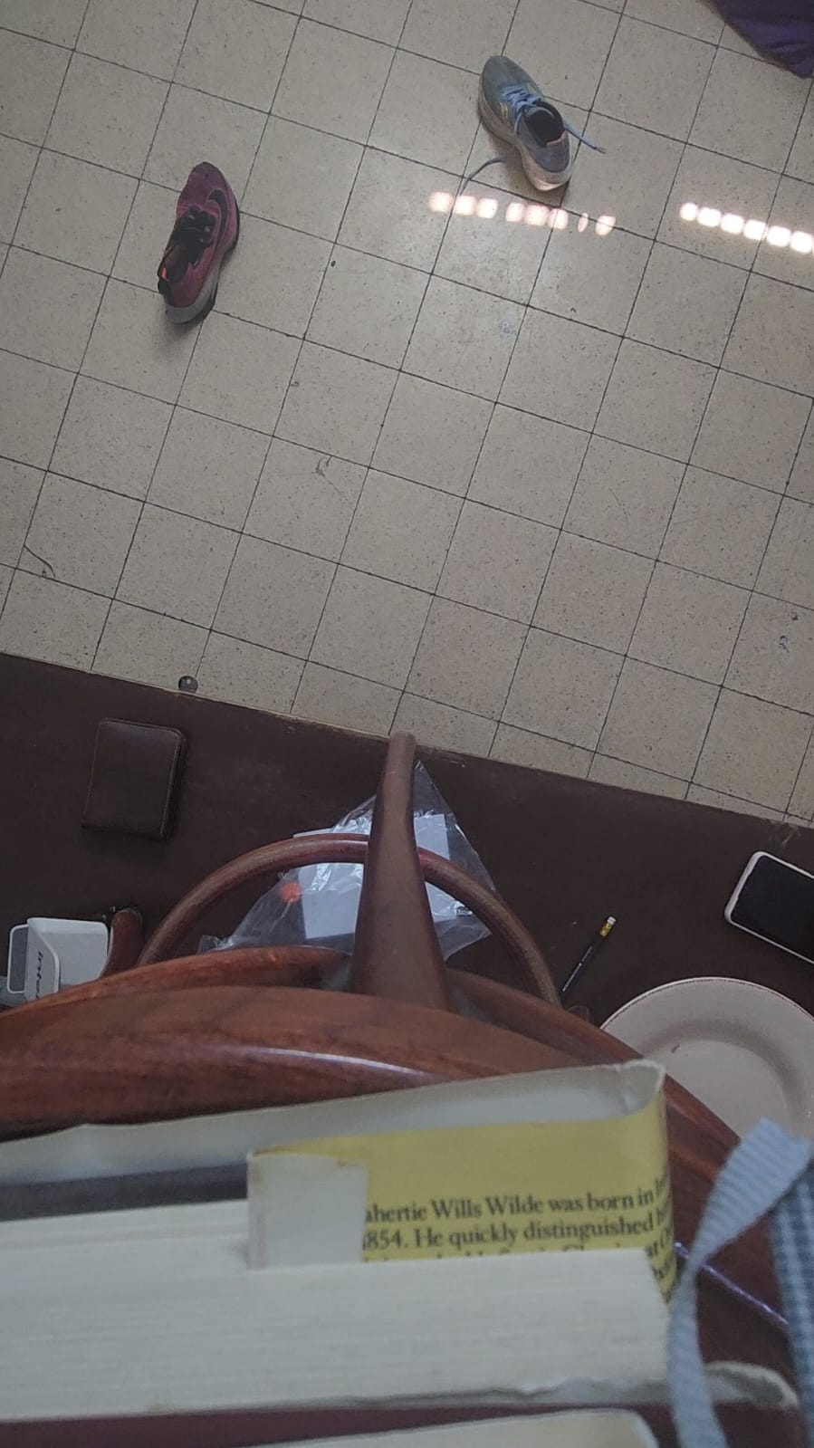
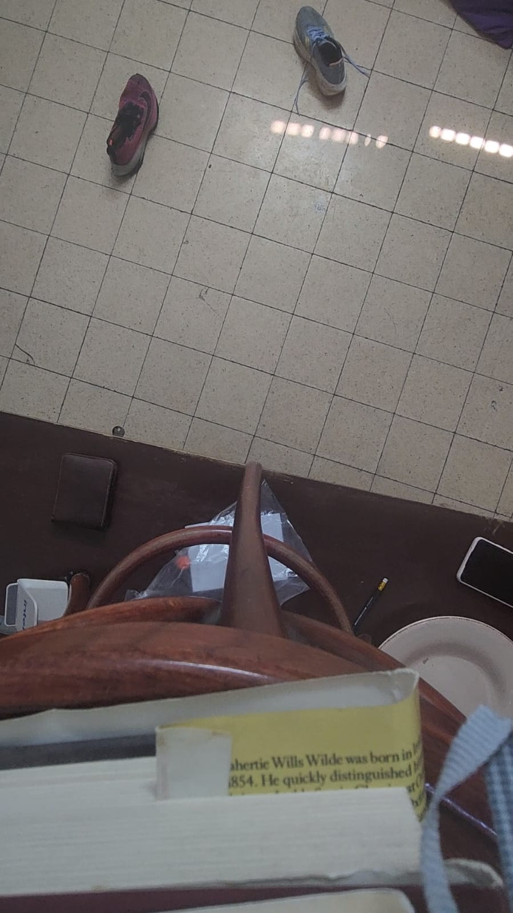
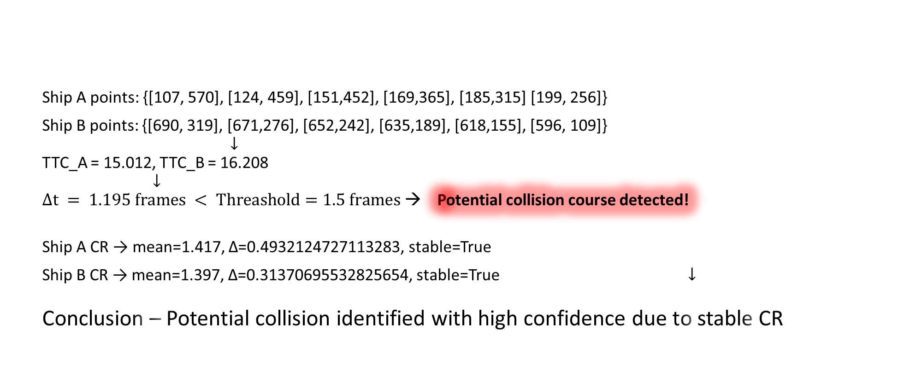
Collision Detection on Scene 3
Ship A points: {[107, 570], [124, 459], [151,452], [169,365], [185,315] [199, 256]}
Ship B points: {[690, 319], [671,276], [652,242], [635,189], [618,155], [596, 109]}
$$↓$$
TTC_A = 15.012, TTC_B = 16.208
$↓$
$Δt = 1.195 frames < Threashold=1.5 frames$ → Potential collision course detected!
Ship A CR → mean=1.417, Δ=0.4932124727113283, stable=True
Ship B CR → mean=1.397, Δ=0.31370695532825654, stable=True$↓$
Conclusion – Potential collision identified with high confidence due to stable CR
→
→
→
→
→

Slide 11
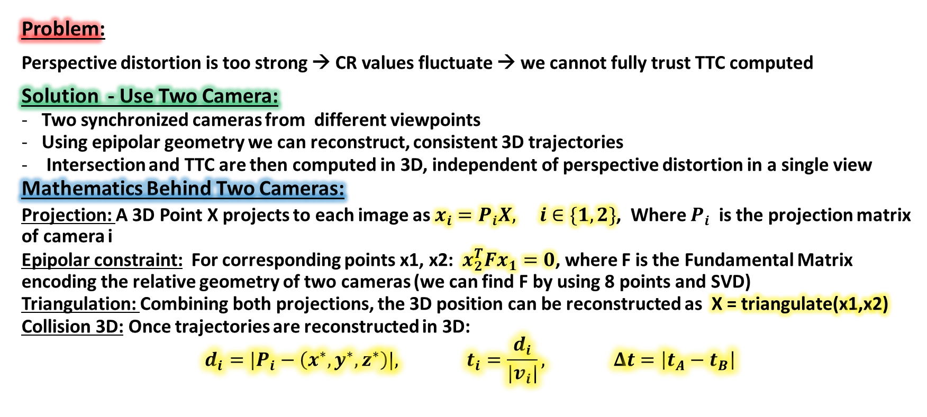
Two Cameras
Problem:
Perspective distortion is too strong → CR values fluctuate → we cannot fully trust TTC computed
Solution - Use Two Camera:
Two synchronized cameras from different viewpoints
Using epipolar geometry we can reconstruct, consistent 3D trajectories
Intersection and TTC are then computed in 3D, independent of perspective distortion in a single view
Mathematics Behind Two Cameras:
Projection: A 3D Point X projects to each image as $x_{i}=P_{i}X, i∈\{1,2\}$, Where $P_{i}$is the projection matrix of camera i
Epipolar constraint: For corresponding points x1, x2: ${ x}_{2}^{T}Fx_{1}=0$, where F is the Fundamental Matrix encoding the relative geometry of two cameras (we can find F by using 8 points and SVD)
Triangulation: Combining both projections, the 3D position can be reconstructed as X = triangulate(x1,x2)
Collision 3D: Once trajectories are reconstructed in 3D:
$$d_{i}=|P_{i}−\left(x^{∗},y^{∗},z^{∗}\right)|, t_{i}=\frac{d_{i}}{|v_{i}|}, Δt=\left|t_{A}−t_{B}\right|$$

Slide 12
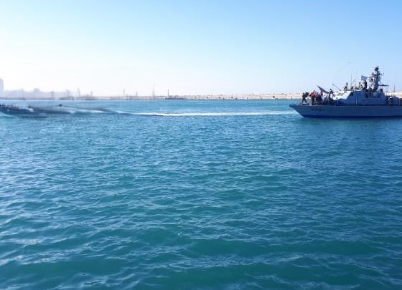
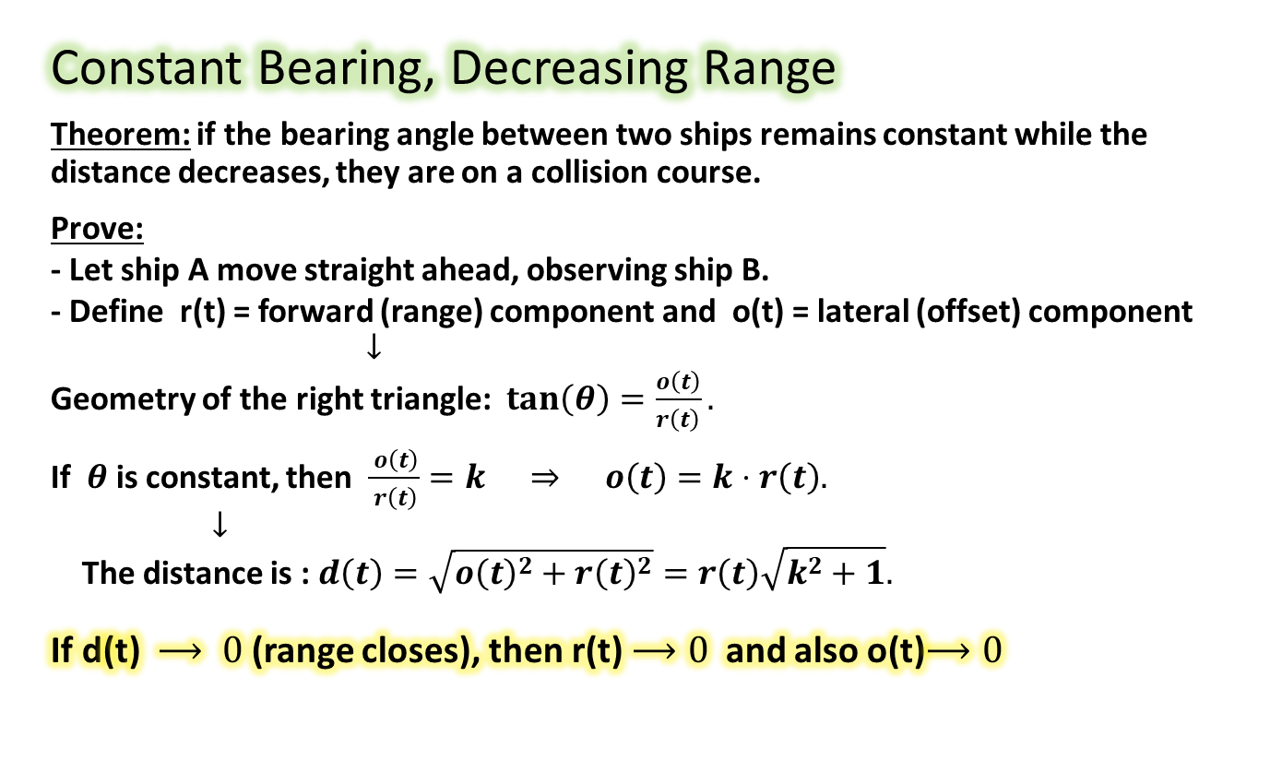
Onboard Camera
Constant Bearing, Decreasing Range
Theorem: if the bearing angle between two ships remains constant while the distance decreases, they are on a collision course.
Prove:
- Let ship A move straight ahead, observing ship B.
- Define r(t) = forward (range) component and o(t) = lateral (offset) component
$$↓$$
Geometry of the right triangle: $\tan\left(θ\right)=\frac{o\left(t\right)}{r\left(t\right)}.$
If $θ$ is constant, then $\frac{ o\left(t\right)}{ r\left(t\right)}=k ⇒ o\left(t\right)=k⋅r\left(t\right).$
$↓$
The distance is : $d\left(t\right)=\sqrt{o{\left(t\right)}^{2}+r{\left(t\right)}^{2}}=r\left(t\right)\sqrt{k^{2}+1}.$
If d(t) $⟶ 0$ (range closes), then r(t)$⟶0$ and also o(t)$⟶0$

Slide 13
Thank you,
see you on the sea

